Slide 1
An introduction to RL and deep RL (2)
Babak Badnava
Multi-agent systems lab, IUST
This slide is mainly taken from silver’s slides

Slide 2
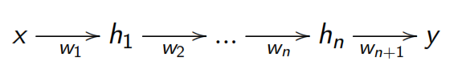
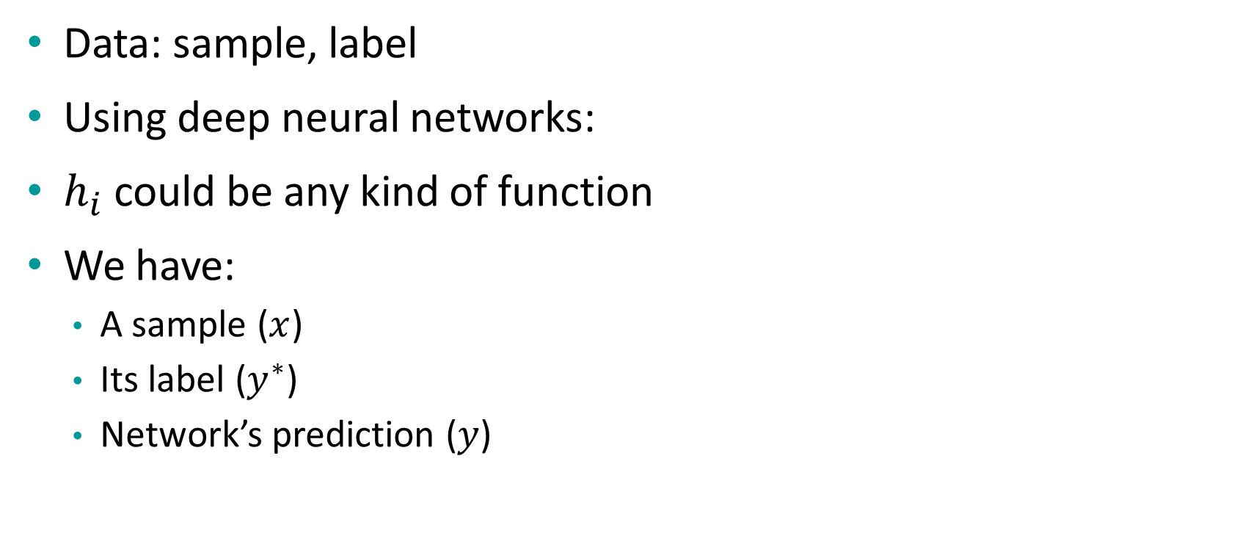
Deep neural networks for supervised tasks
Data: sample, label
Using deep neural networks:
$h_{i}$ could be any kind of function
We have:
A sample ($x$)
Its label ($y^{∗}$)
Network’s prediction ($y$)

Slide 3

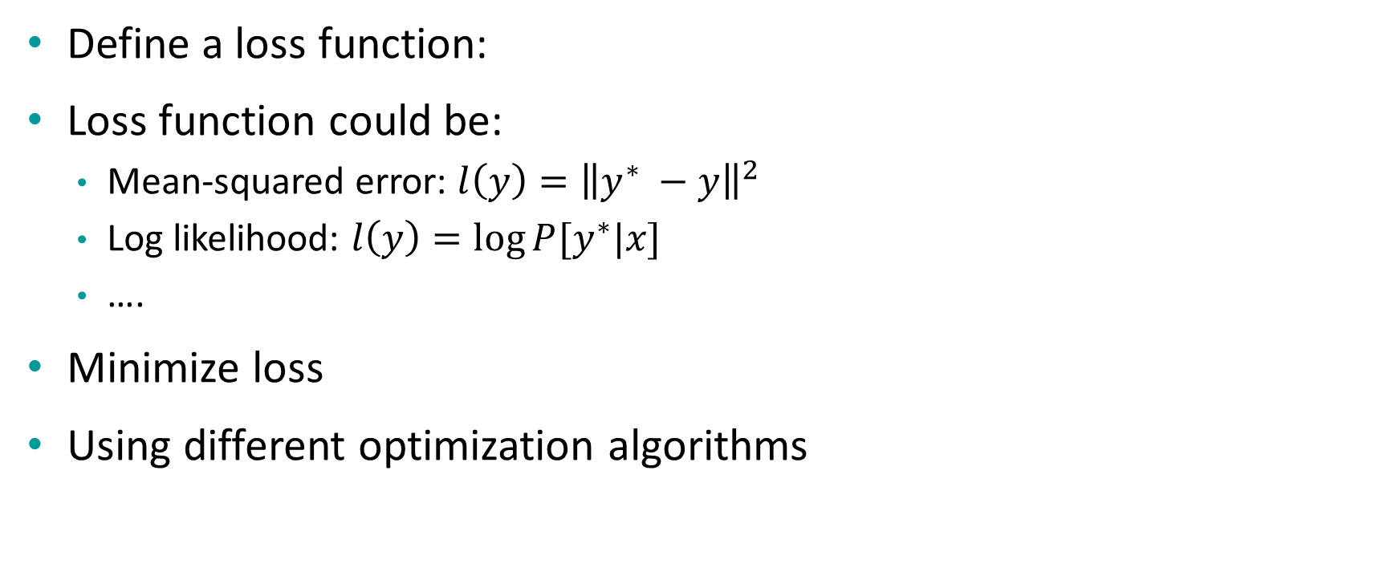
Deep neural networks for supervised tasks (2)
Define a loss function:
Loss function could be:
Mean-squared error: $l\left(y\right)={\left\|y^{∗} −y\right\|}^{2}$
Log likelihood: $l\left(y\right)=\log{P[y^{∗}|x]}$
….
Minimize loss
Using different optimization algorithms

Slide 4
Overview of approximation methods
Value estimation
Use a neural network to approximate value function
Define a policy function on top of it
Policy gradient
Use a neural network to approximate policy function directly

Slide 5
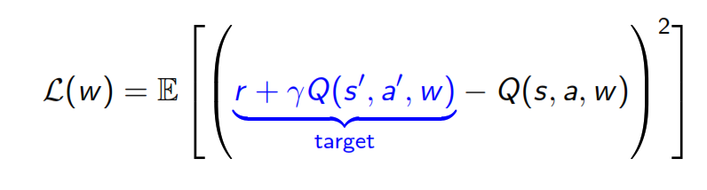
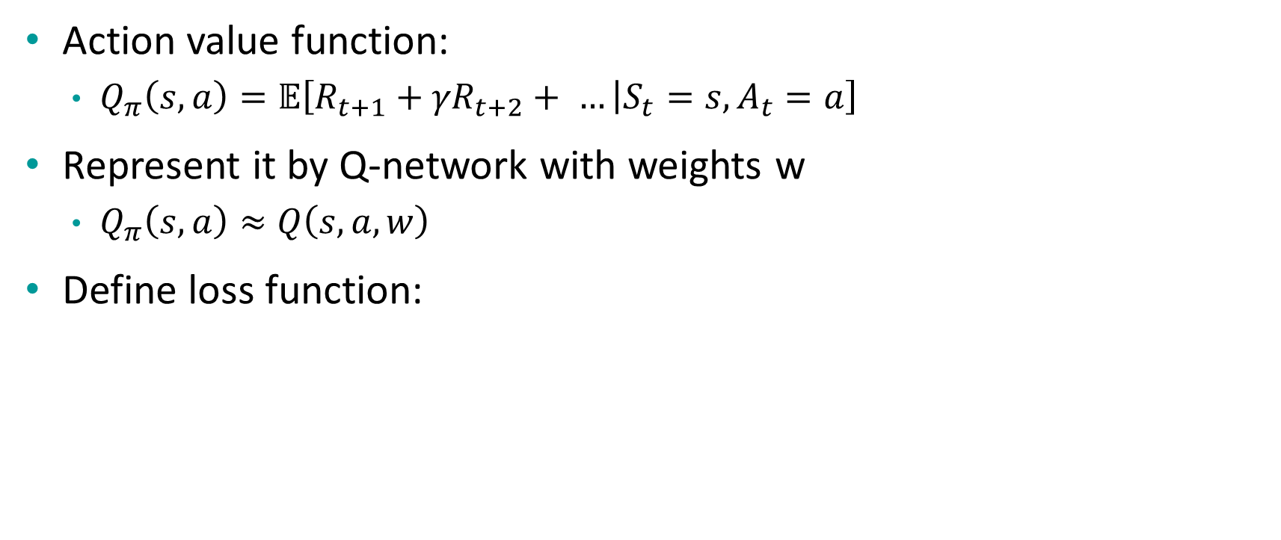
Let’s apply it to SARSA
Action value function:
$Q_{π}\left(s,a\right)=𝔼\left[R_{t+1}+{γR}_{t+2}+ … | S_{t}=s, A_{t}=a\right]$
Represent it by Q-network with weights w
$Q_{π}\left(s,a\right)≈Q\left(s,a,w\right)$
Define loss function:

Slide 6
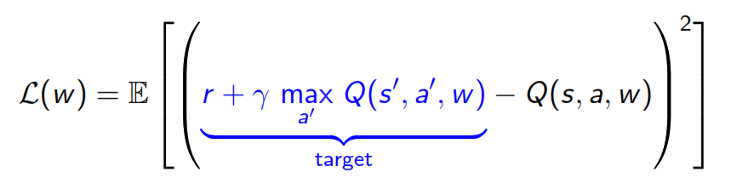

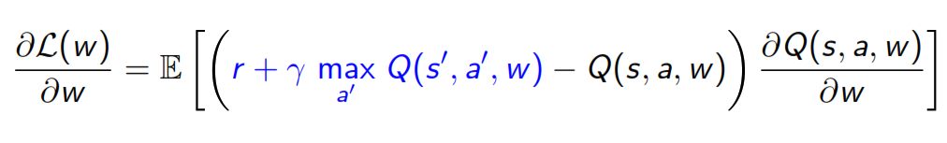
How about Q-learning?
Loss function:
Optimize this using SGD, using

Slide 7
Summary
Use this network to estimate value function instead of a Q-table
Nothing else have been changed
Does it work well?
Neural network
State, action
Q(s, a, w)

Slide 8
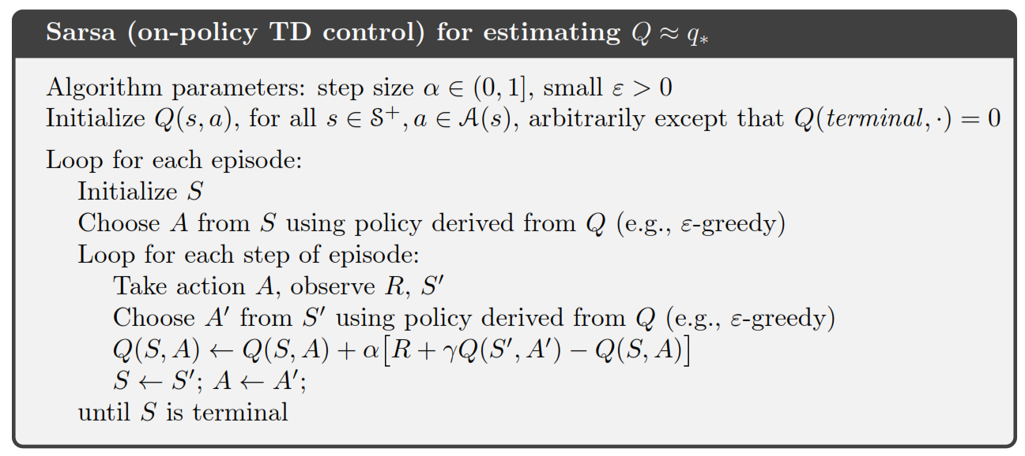
Compare
Algorithm from Sutton 2018

Slide 9
Compare (2)
Initialize weights
Loop for each episode:
Initialize s
Choose a from s using policy derived from Q(s, a, w)
Loop for each step of episode:
Take action a, observe r, s’
Choose a’ from s’ using policy derived from Q(s’, a’, w)
Compute gradient of loss and update the network
s <- s’; a <- a’
Until s is terminal

Slide 10
Does it work well?
Oscillates or diverges
Why?
Data is sequential
Successive samples are correlated
Policy changes rapidly with slight change to Q-values
Distribution of data will change
Scale of rewards and Q-values is unknown

Slide 11
What to do?
Use experience reply
Break correlation between data
Freeze target Q-network
Avoid oscillations
Clip rewards or normalize network adaptively

Slide 12
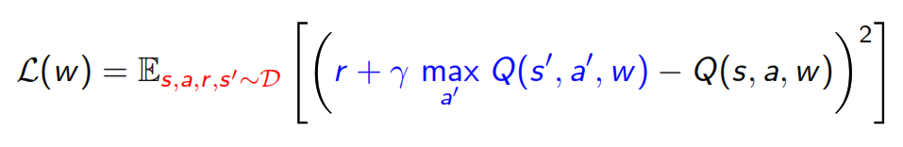
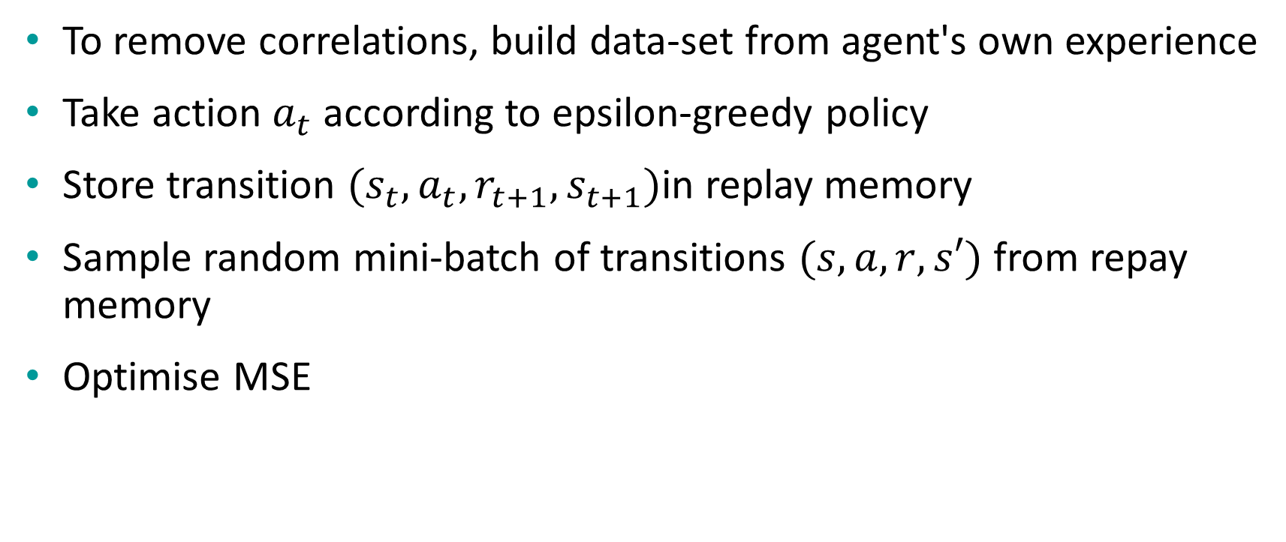
Stable Deep RL: experience replay
To remove correlations, build data-set from agent's own experience
Take action $a_{t}$ according to epsilon-greedy policy
Store transition $(s_{t},a_{t},r_{t+1},s_{t+1})$in replay memory
Sample random mini-batch of transitions $(s, a, r, s′)$ from repay memory
Optimise MSE

Slide 13

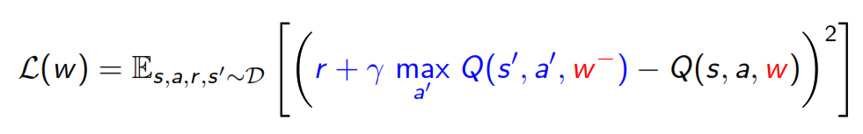
Stable Deep RL: fixed target Q-network
Use target Q-network with fixed parameter
Choose action based on the target Q-network
Compute Q-learning target w.r.t old, fixed parameter
Optimize MSE
Periodically update fixed parameters

Slide 14
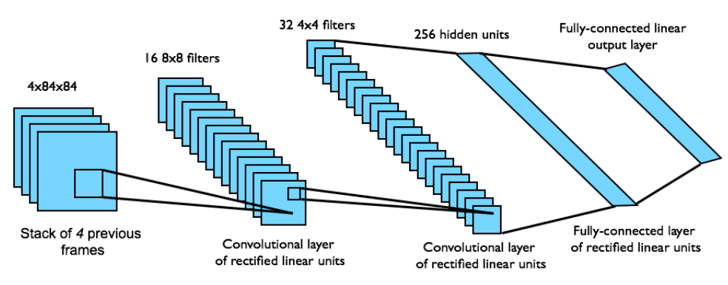
DQN architecture in Atari
End-to-end learning of values Q(s, a) from pixels s
Input state s is stack of raw pixels from last 4 frames
Output is Q(s, a) for 18 joystick/button positions
Reward is change in score for that step

Slide 15

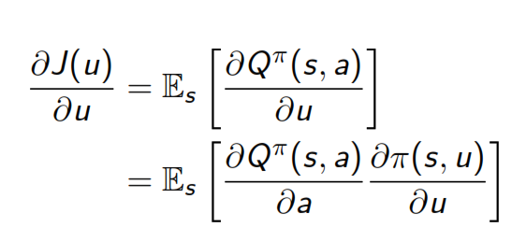
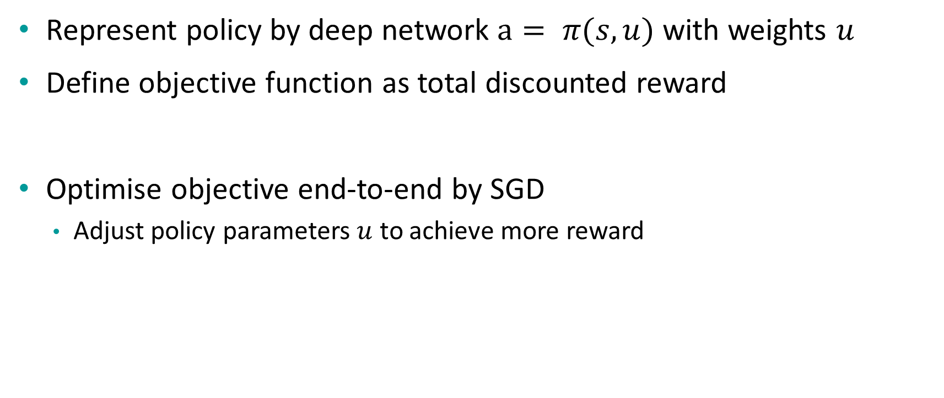
Policy gradient
Represent policy by deep network $a= π(s, u)$ with weights $u$
Define objective function as total discounted reward
Optimise objective end-to-end by SGD
Adjust policy parameters $u$ to achieve more reward

Slide 16




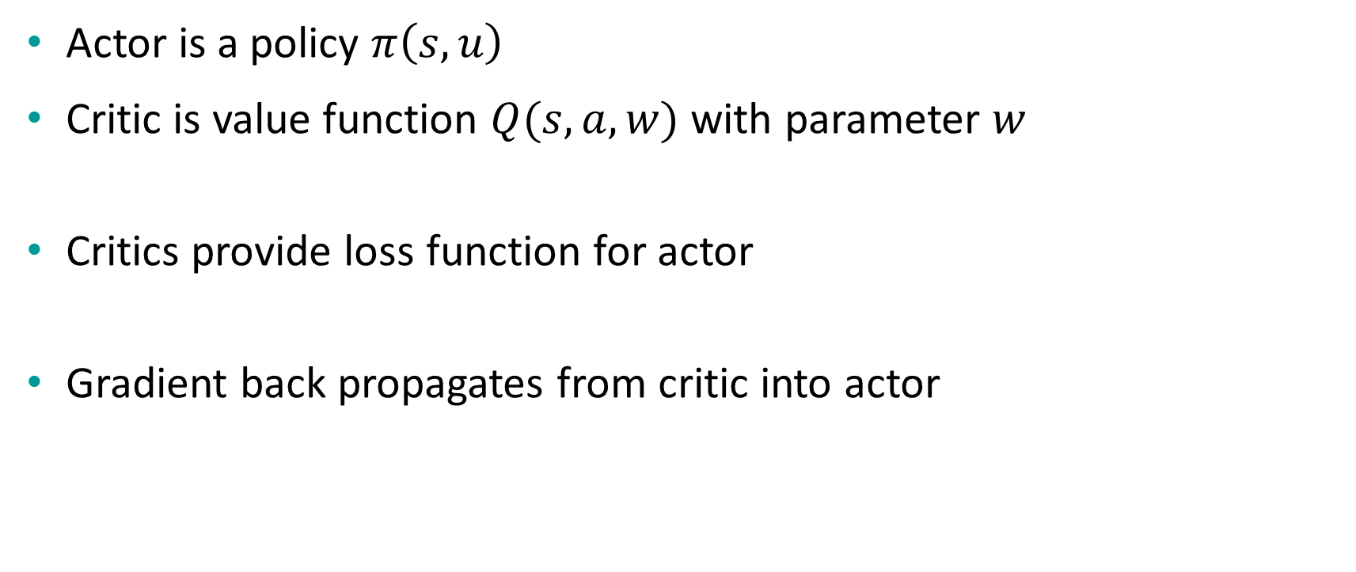
Actor-Critic method
Actor is a policy $π\left(s, u\right)$
Critic is value function $Q(s, a, w)$ with parameter $w$
Critics provide loss function for actor
Gradient back propagates from critic into actor

Slide 17
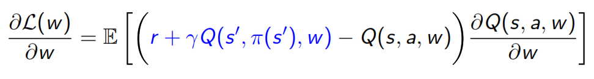
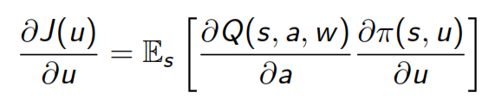
Actor-Critic: Learning rules
Critic estimates value of current policy by Q-learning
Actor updates policy in direction that improves Q

Slide 18
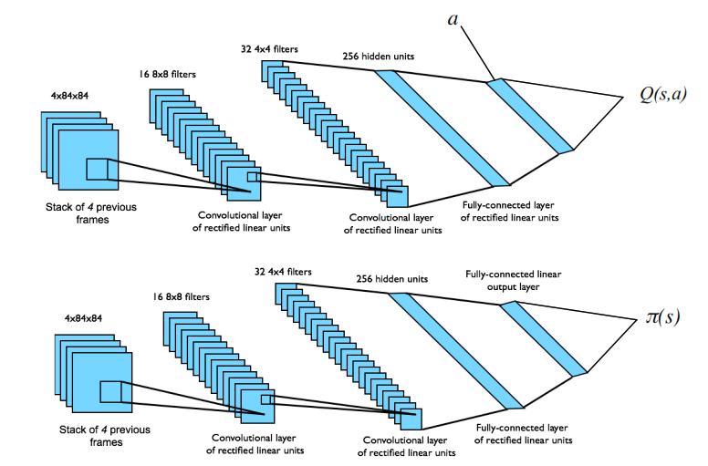
Architecture and tips
Use experience reply
Freeze target network

Slide 19
How to improve?
Run multiple simulation simultaneously instead of reply memory
Try this one as a practice
And think about its advantageous
Use Transfer Learning
…

Slide 20
A simple python code

Slide 21
References
David Silver’s slide
An introduction to Reinforcement Learning by Sutton 2nd edition
Berkeley’s deep RL boot camp materials available at here

Slide 22
Questions?

